Slide 1
Best Start-Ups in Toronto
Data Science Capstone project
Jeyakumar B
Mar-2020

Slide 2
Agenda
Introduction
Data Mining
Data Processing
Data Analysis Methodology
Optimal Location for Business
Discussion
Future Actions
Conclusion

Slide 3
Introduction
NxtFut Group is New York based Multi-industry company want to start their new
venture in Toronto
Success of this new venture is most important for them to grow in Toronto
NxtFut wants to find what is the best business to start in Toronto
This data science project will deals with below problem.
1. What is the best business to start in Toronto
2. How the community will receive it
3. what is the best location to start the branch office.

Slide 4
Data Mining - Goals
1. Identify the most common places people gather
2. Identify the most popular business on New York missing in Toronto
3. Identify the best place to start the business around centre of city of Toronto
4. Compare New York and Toronto demographics data
5. Identify will the Toronto community accept the selected business

Slide 5
Data Mining – Selecting Data
Foursquare – To select Borough, Neighbourhood and geo location data
Demographics – 2016-2017 census data
Age & Population data will be used
Most common venues of Toronto and Newyork
Distance between city centre to each venues

Slide 6
Data Processing and Transformation
We have to overcome processing of few messy data to determine the appropriate format
Have grouped age and racial data into abstract categories for effective analysis
To create a single table that contain all below data
neighbourhood
latitude-longitude details
various venue categories
most common places
distance between the venues and city centre

Slide 7
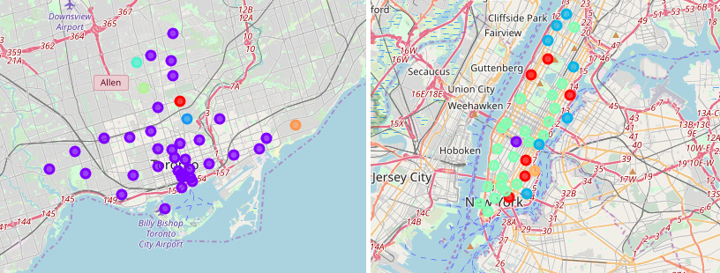
Data Analysis Methodology
Toronto vs New York neighbourhoods
Geographical chart of both Toronto and Manhattan states both are different in shape
As both the cities are financial Hub we can’t compare based on the shape or region.

Slide 8
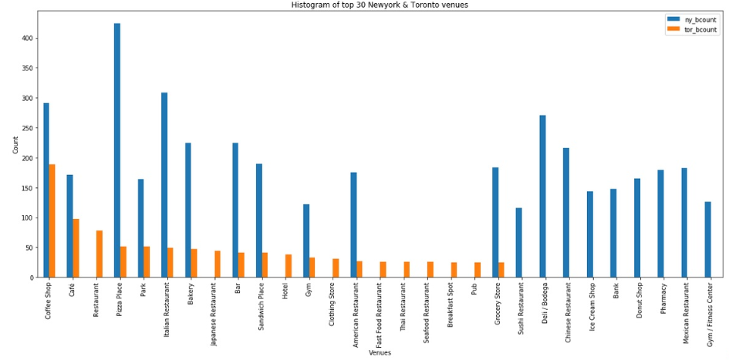
Data Analysis Methodology
Toronto vs Manhattan Businesses
It is important to understand the businesses, various industries, interested areas, gatherings in both New York and Toronto
Let we collect the top 30 most common venues of both cities
Have Identified the list of business popular in Manhattan and missing in Toronto

Slide 9
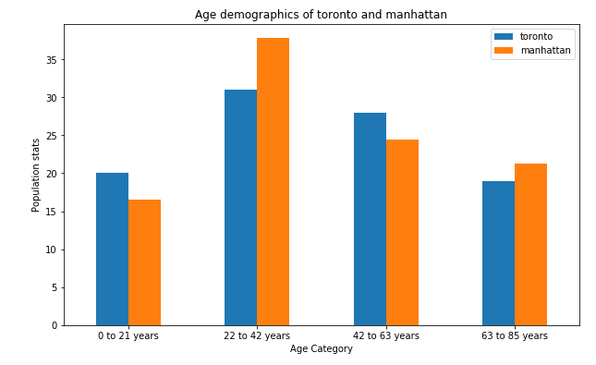
Data Analysis Methodology
Age Distribution
Both the cities are similar in terms of distribution of population throughout all ages
There is difference between population but distribution is similar

Slide 10
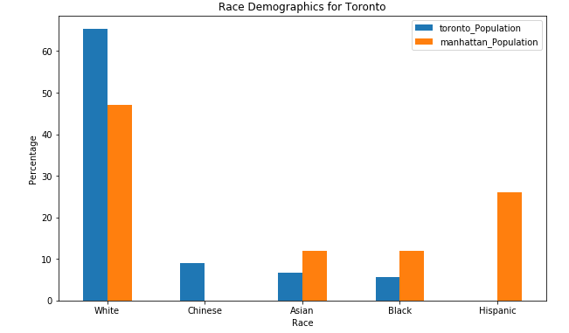
Data Analysis Methodology
Racial Distribution
Toronto has more population of White than Manhattan
Toronto has Chinese population where as Manhattan has Hispanic population
Toronto has comparatively less population of Asian and Black than Manhattan
Collectively Toronto has more white and Chinese population

Slide 11
Data Analysis Methodology
Chinese Restaurant
Mexican Restaurant
Donut Shop
Ice Cream Shop
Pharmacy
Possibly Best Profitable Businesses in Toronto

Slide 12
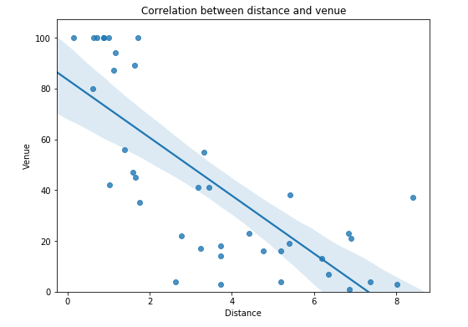
Data Analysis Methodology
Distance between City Centre and Common Venues
Distance and most common places of Toronto are negatively correlated
Common places are getting reduced when we go far from Yonge-Dundas Square

Slide 13
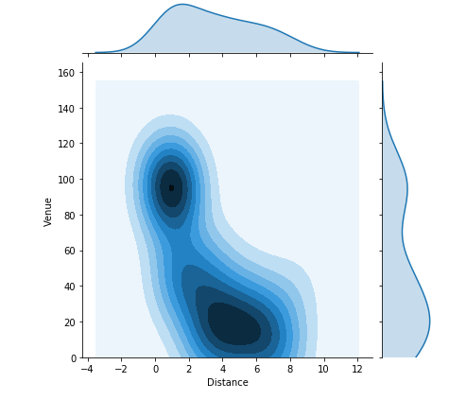
Optimal Location for Business
Within 2 kms of Yonge-Dundas Square or
Between 4 km to 6 km of Yonge-Dundas Square

Slide 14
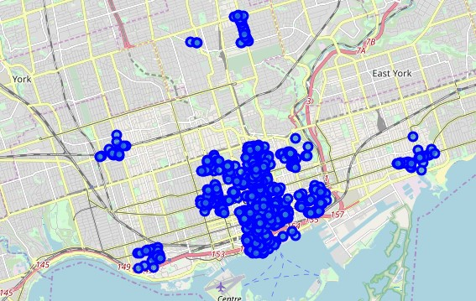
Optimal Location for Business
This explains us that all the venues located between 4 – 6 kms are scattered around
Best place to start the identified business is within 2kms of Yonge-Dundas Square

Slide 15
Discussion
Pharmacy is one of the good businesses to start with in Toronto
We have lot of medical centres and Hospitals in the region but we have very less number of pharmacies
Recommended Donut, Ice cream, Games parlour to attract kids and young family
Mexican, Chinese restaurant and food delivery to attract families
Best business for NxtFut customer is Food complex that hold both restaurants, Donut, Ice cream, Games parlours

Slide 16
Future Action
Identify future growth and shape of the business
Identify other best provinces to expand the business
Analyse the Revenue for next 5 years and factors that affects revenue

Slide 17
Conclusion
We have identified the best strategic location to start the business
Have identified best profitable business in Toronto
We have seen the similarities and dissimilarities of Toronto and Manhattan
Identified future scope of analysis for our assured success in dynamic environment

